Slide 1
In this chapter, the following topics will be discussed:
• Trimming Sketch Entities
• Extending Sketch Entities
• Offsetting Sketch Entities
• Creating Construction Entities
• Mirroring Sketch Entities
• Patterning Sketch Entities
• Creating a Sketch Fillet
• Creating a Sketch Chamfer
• Scaling Sketch Entities
• Breaking Sketch Entities

Slide 2
Trimming Sketch Entities
You can trim the unwanted sketch entities to their nearest intersection by using the Trim tool.

Slide 4
In addition to trimming the entities by clicking the left mouse button, you can also drag the cursor over the entities to be trimmed. For doing so, after activating the Trim tool, drag the cursor over the entities to be trimmed by pressing and holding the left mouse button.
NOTE: If an intersection is not detected in the entity to be trimmed, then the entity will be deleted from the sketch.

Slide 5
Extending Sketch Entities
You can extend sketch entities up to their nearest intersection by using the Extend tool.

Slide 6
You can access the Extend tool in the MODIFY drop-down menu in the SKETCH contextual tab of the Toolbar.

Slide 7
Offsetting Sketch Entities
You can offset the entities of a sketch or the edges of a feature at a specified offset distance by using the Offset tool.

Slide 8
Creating Construction Entities
In Fusion 360, you can activate the construction mode for creating construction entities in the drawing area by using the Construction tool in the Linetype area of the SKETCH PALETTE dialog box.

Slide 9
Mirroring Sketch Entities
You can mirror sketch entities about a mirroring line by using the Mirror tool of the CREATE drop-down menu in the SKETCH contextual tab of the Toolbar.
NOTE: When you mirror entities, a symmetric relation is applied between the original entities and the mirrored entities with respect to the mirroring line.

Slide 10
Patterning Sketch Entities
In Fusion 360, you can create rectangular and circular patterns of sketch entities by using the Rectangular Pattern and Circular Pattern tools, respectively.
Rectangular Pattern Tool
The Rectangular Pattern tool is used for creating multiple instances of one or more sketch entities in linear directions.

Slide 12
NOTE: The number of pattern instances specified in the Quantity field is counted along with the parent or original instance.

Slide 15
NOTE: To edit the parameters of an already created rectangular pattern, click on the symbol of rectangular pattern that appears near the parent entity in the drawing area.

Slide 16
Circular Pattern Tool
The Circular Pattern tool is used for creating multiple instances of one or more sketch entities in a circular manner about a center point.

Slide 17
NOTE: The number of pattern instances specified in the Quantity field is counted along with the parent or original instance.

Slide 18
NOTE: To edit the parameters of the already created circular pattern, click on the symbol of circular pattern that appears in the drawing area.

Slide 19
Creating a Sketch Fillet
A sketch fillet is used for removing the corner at the intersection of two sketch entities (lines or arcs) by creating a tangent arc of constant radius.

Slide 20
Creating a Sketch Chamfer
A sketch chamfer is a beveled corner created at the intersection of any two non-parallel line entities.

Slide 21
Equal Distance Chamfer
The Equal Distance Chamfer tool is used for creating a chamfer at an equal distance from the intersection of both the selected line entities.

Slide 22
Distance and Angle Chamfer
The Distance and Angle Chamfer tool is used for creating a chamfer by specifying an angle from the first selected line entity and a distance from its intersection with the second selected line entity.

Slide 23
Two Distance Chamfer
The Two Distance Chamfer tool is used for creating a chamfer by specifying different distance values from the intersection of each selected line entity.

Slide 24
Scaling Sketch Entities
You can increase or decrease the scale of sketch entities by using the Sketch Scale tool.

Slide 25
Breaking Sketch Entities
In Fusion 360, you can break a sketch entity into two or more segments at its intersection with other entities by using the Break tool of the MODIFY drop-down menu.

Slide 26
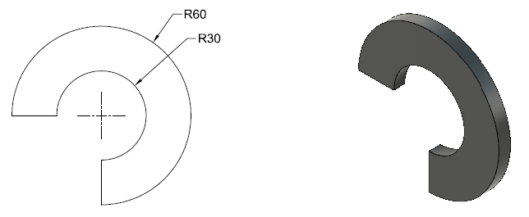
Tutorial 1
Draw the sketch of the model, as shown in Figure 3.52. The dimensions and the model shown in this figure are for your reference only.
To create this tutorial, follow the steps given in the textbook.

Slide 27
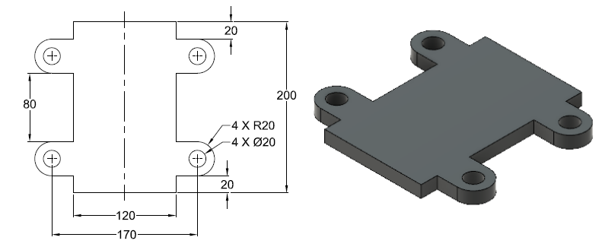
Tutorial 2
Draw the sketch of the model, as shown in the figure. The dimensions and the model shown in the figure are for your reference only.
To create this tutorial, follow the steps given in the textbook.

Slide 28
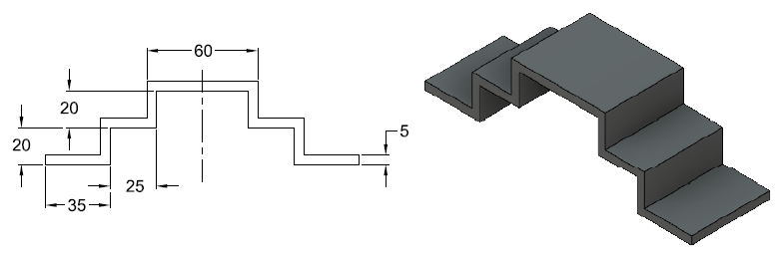
Tutorial 3
Draw the sketch of the model shown in the figure. The dimensions and the model shown in the figure are for your reference only. All dimensions are in mm.
To create this tutorial, follow the steps given in the textbook.

Slide 29
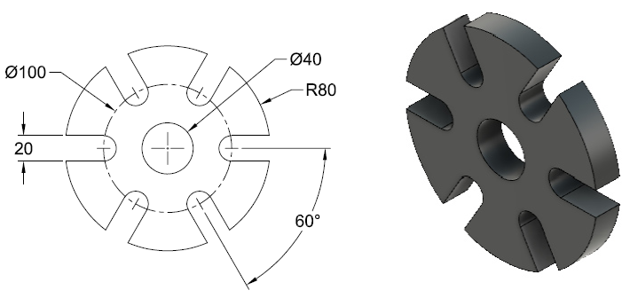
Hands-on Test Drive 1
Draw the sketch of the model shown in the figure. The dimensions and the model are for your reference only. All dimensions are in mm.

Slide 30
Hands-on Test Drive 2
Draw the sketch of the model shown in the figure. The dimensions and the model are for your reference only. All dimensions are in mm.

Slide 31
Summary
This chapter introduced various editing and modifying operations by using various editing tools such as Trim, Extend, Offset, Mirror, Rectangular Pattern, Circular Pattern, Fillet, and Chamfer. The pattern tools discussed in this chapter allow you to create rectangular and circular sketch patterns. It also described the method for creating construction sketch entities by using the Construction tool and breaking sketch entities by using the Break tool.

Slide 32
Questions
The ________ tool is used for offsetting sketch entities at a specified offset distance.
You can increase or decrease the scale of sketch entities by using the ________ tool.
While offsetting sketch entities, if you select the ______ check box in the OFFSET dialog box, all the contiguous entities of the selected entity get automatically selected.
You can trim the unwanted sketch entities to their nearest intersection by using the ________ tool.
On activating the ________ tool in the Linetype area of the SKETCH PALETTE dialog box, you can create construction entities in the drawing area.

Slide 33
The ________ tool is used for breaking a sketch entity into two or more than two segments at its point of intersection with other entities.
The ________ tool is used for extending sketch entities up to their nearest intersection.
The number of pattern instances specified in the Quantity field include the parent or original instance selected to pattern. (True/False)
You cannot recall the skipped pattern instances. (True/False)

